Slide 1

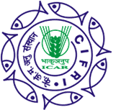
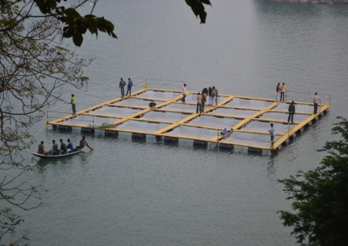
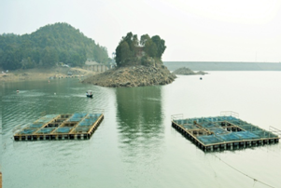
ICAR-Central Inland Fisheries Research Institute Barrackpore, Kolkata-700120
Online Training on
Production Enhancement through Cage Culture in inland open waters
Date: 011.12.2020 Time: 11:00 am – 1:00 pm
Training objectives
Basic concept of Cage Culture
Importance of Cage Culture
Operational knowledge to adopt cage culture technology
Target group for the Online Training
Fishers, fish farmers, entrepreneurs, rural youth, Cooperative Society members of reservoirs/wetlands across Maharashtra, Madhya Pradesh, Bihar, Uttar Pradesh
Chief Patron: Dr. T. Mohapatra, DG, ICAR, New Delhi
Patron: Dr. J.K. Jena, DDG (Fy. Sc.), ICAR, New Delhi
Convener: Dr. B.K. Das, Director, ICAR-CIFRI, Barrackpore
Coordinators: Dr. M. A. Hassan, Head, FEM Div. & Dr. A.K. Das, I/C, T&E Unit
Co-coordinators: Ms. Gujan Karnatak and Dr. Raju Baitha
Link: https://meet.google.com/nbk-cmxe-tps

